Slide 1


Slide 2
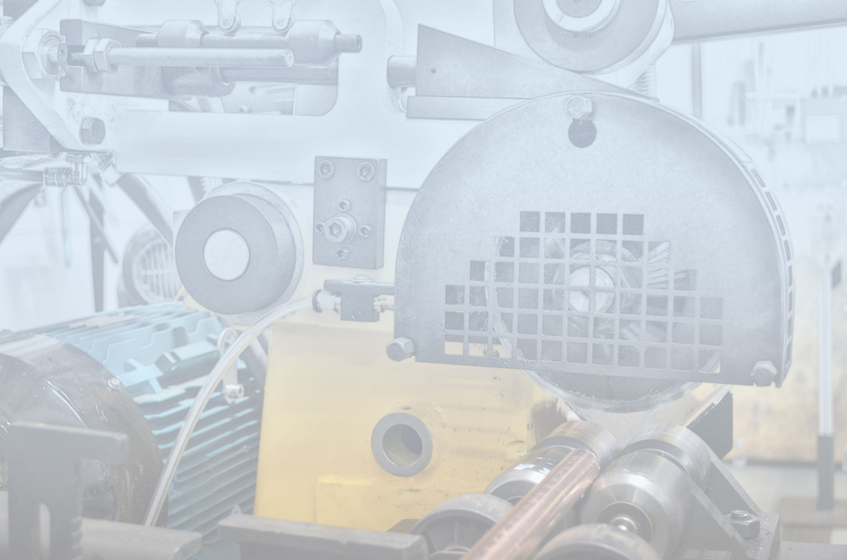
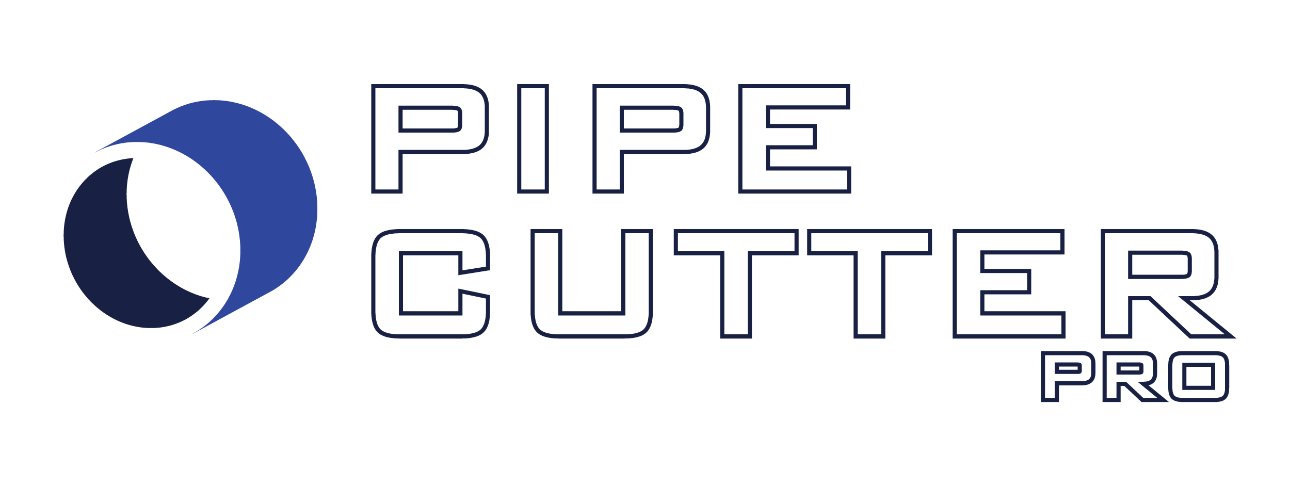


Slide 3

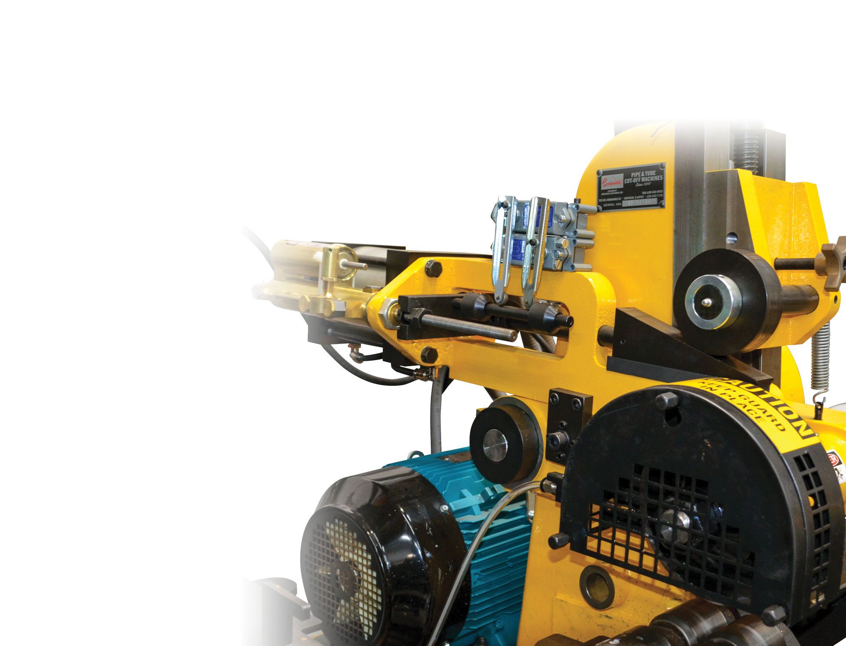
no burrs, no chips,
no contaminants
• No burrs after cuts.
Saves valuable time by eliminating the
deburring process.
• No chips.
Roll forming process leaves no chips after the cut.
• No coolant.
Copper processing requires no coolant
which is great for medical gas applications.
• Copper, black, EMT, or plastic.
Capable of cutting 1/2” - 4” copper and up to
2 1/2” black pipe.

Slide 4
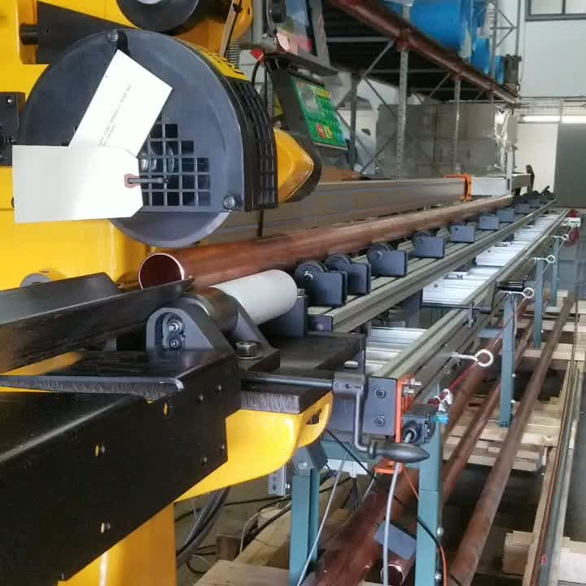
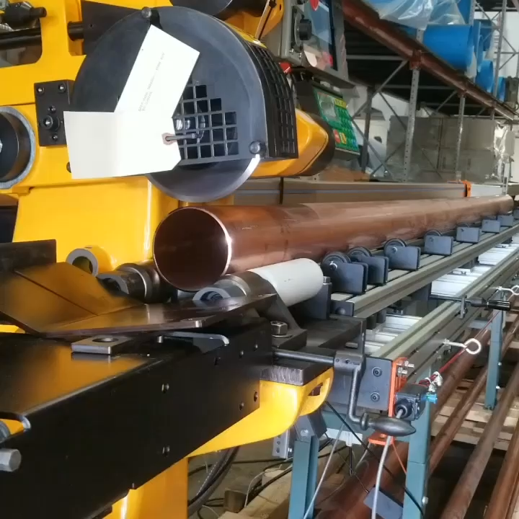
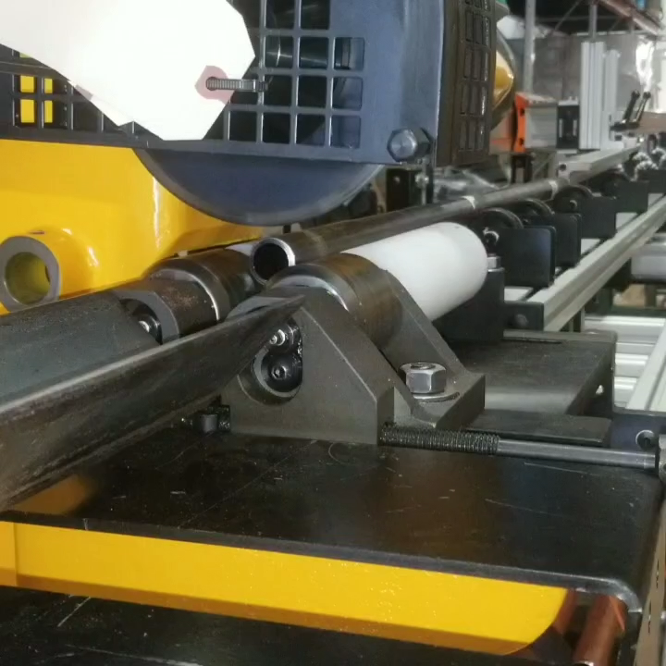
no burrs, no chips,
no contaminants

Slide 5
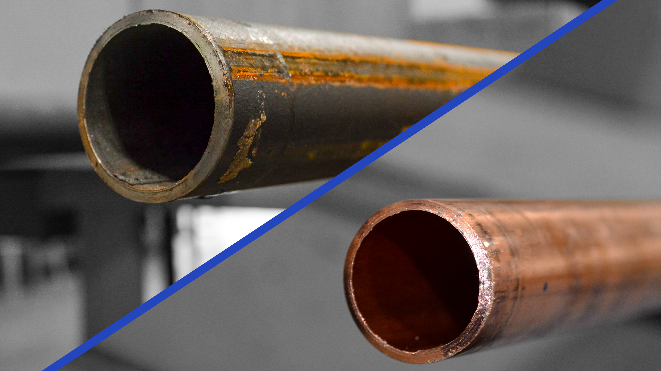
cuts COPPER,
BLACK, EMT,
or PLASTIC

Slide 6
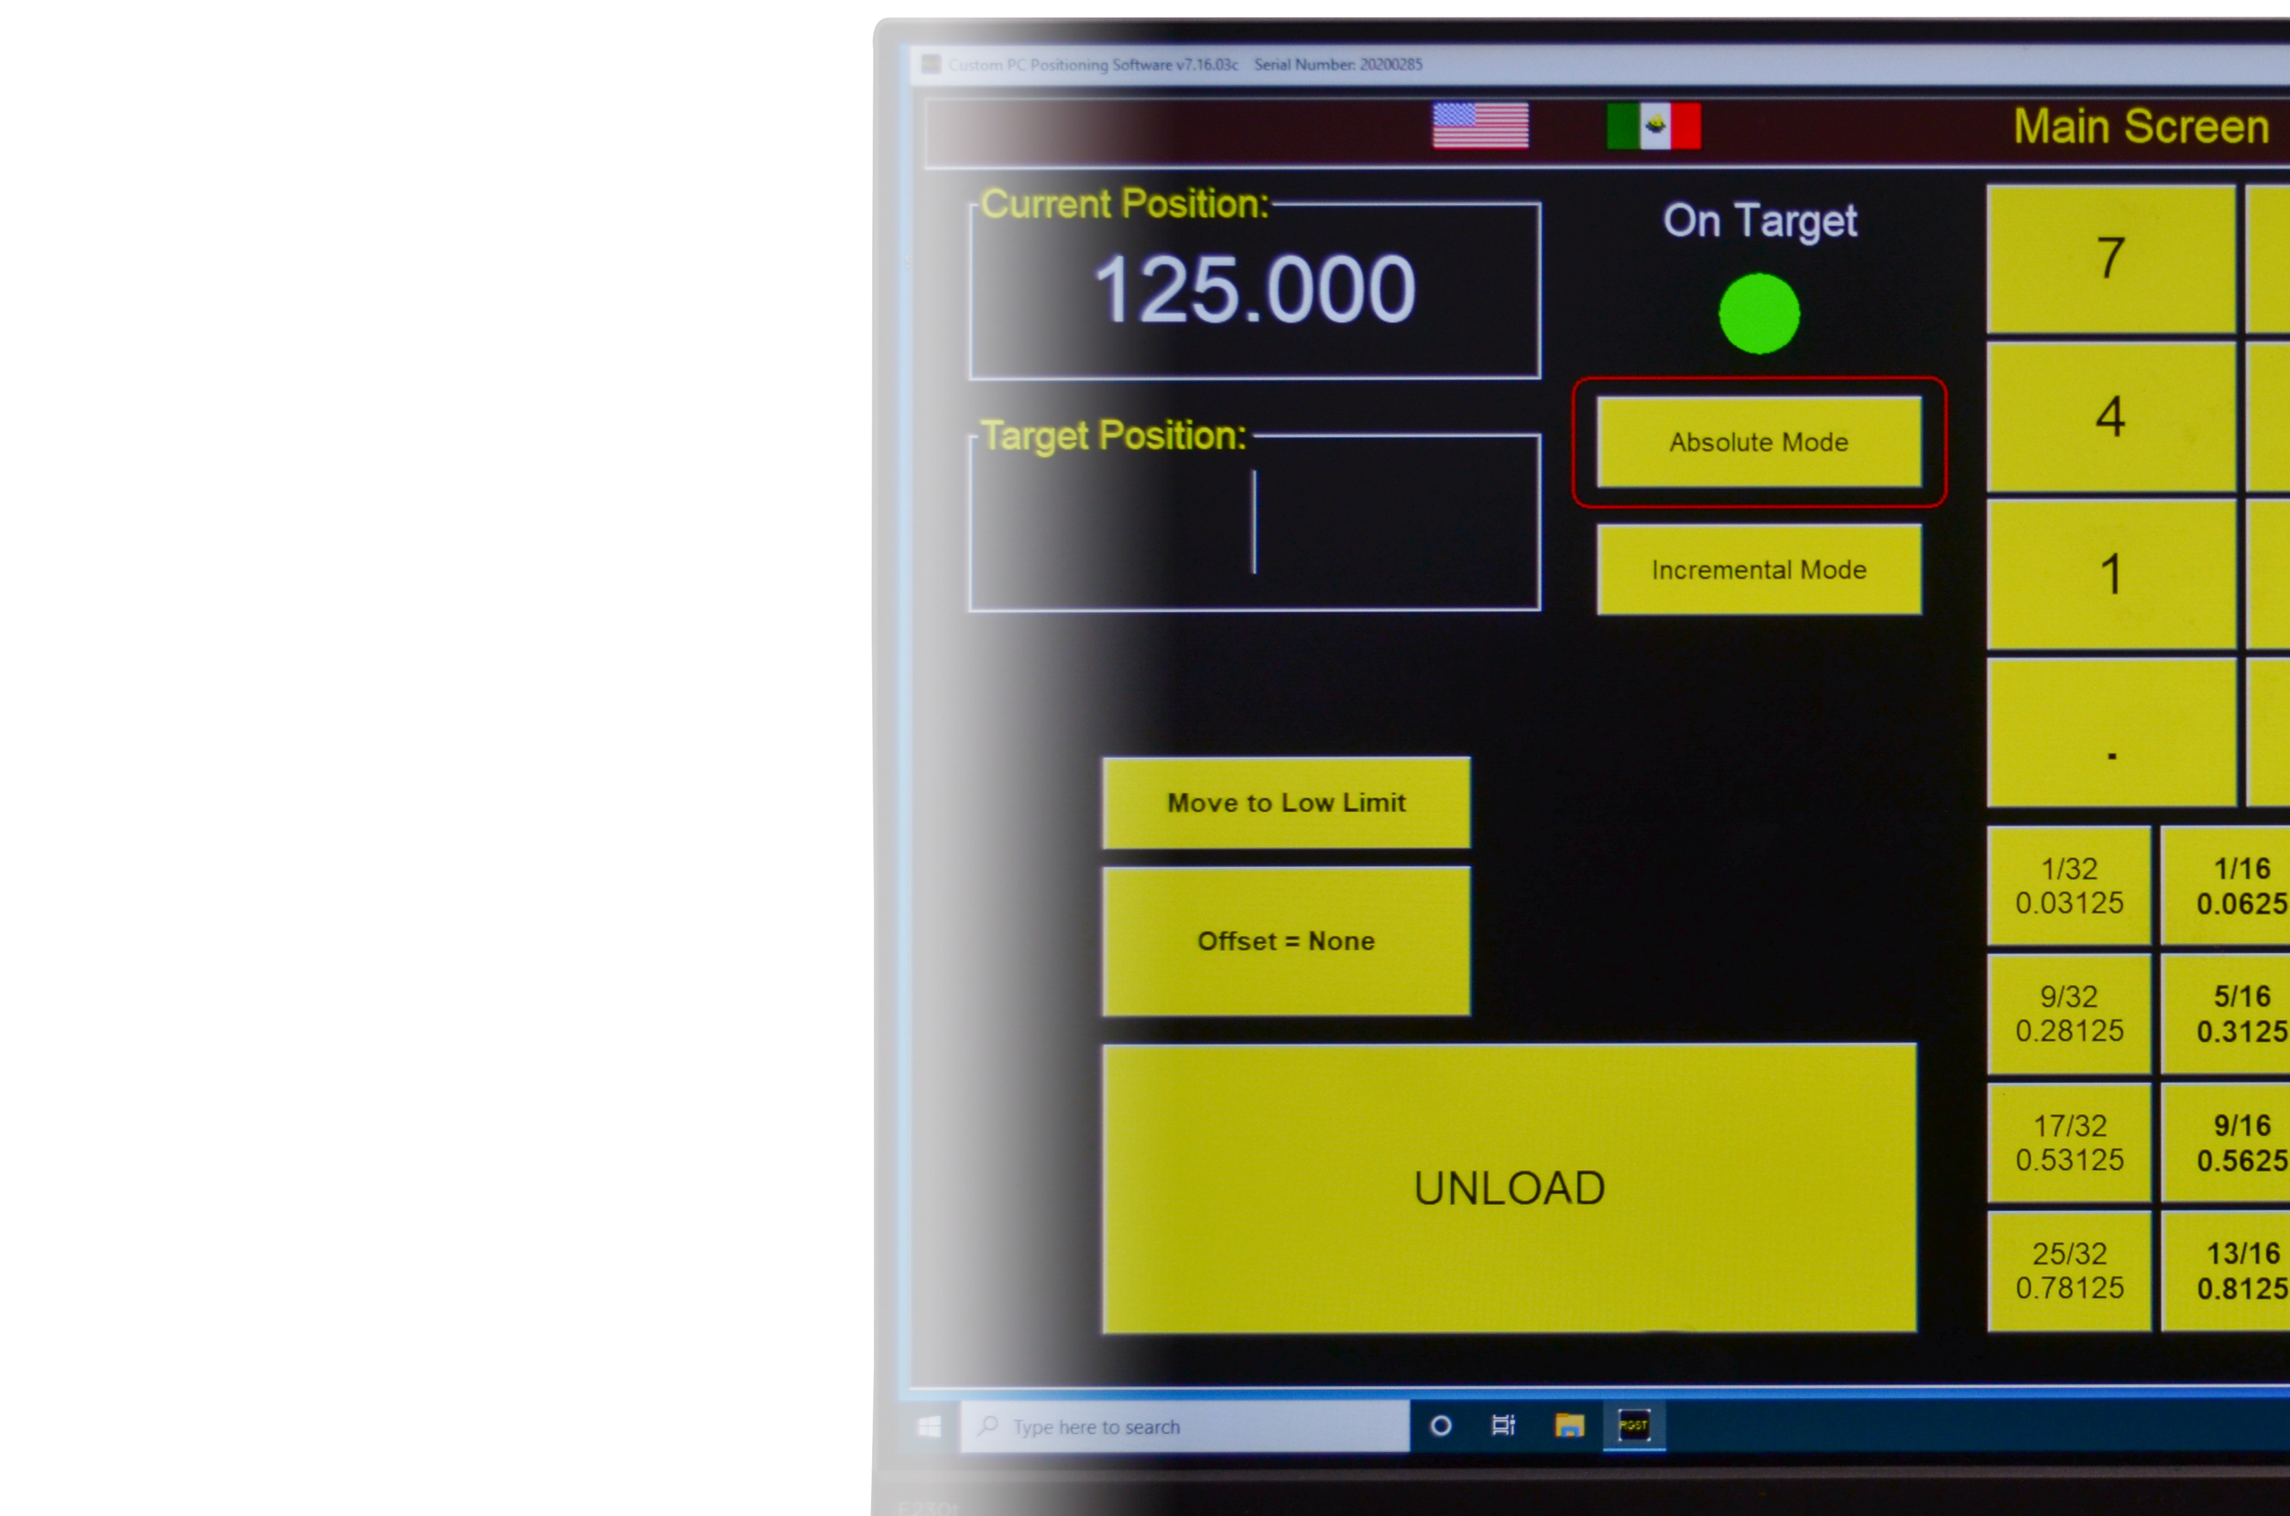

INTEGRATED
• Accurate, reliable, increases productivity,
improves quality, and reduces waste.
• Intuitive operation and networking via Wi-Fi,
Ethernet, USB, MEP based programming
or create your own cutlist.
• Rapid development platform with
constant updates.

Slide 7
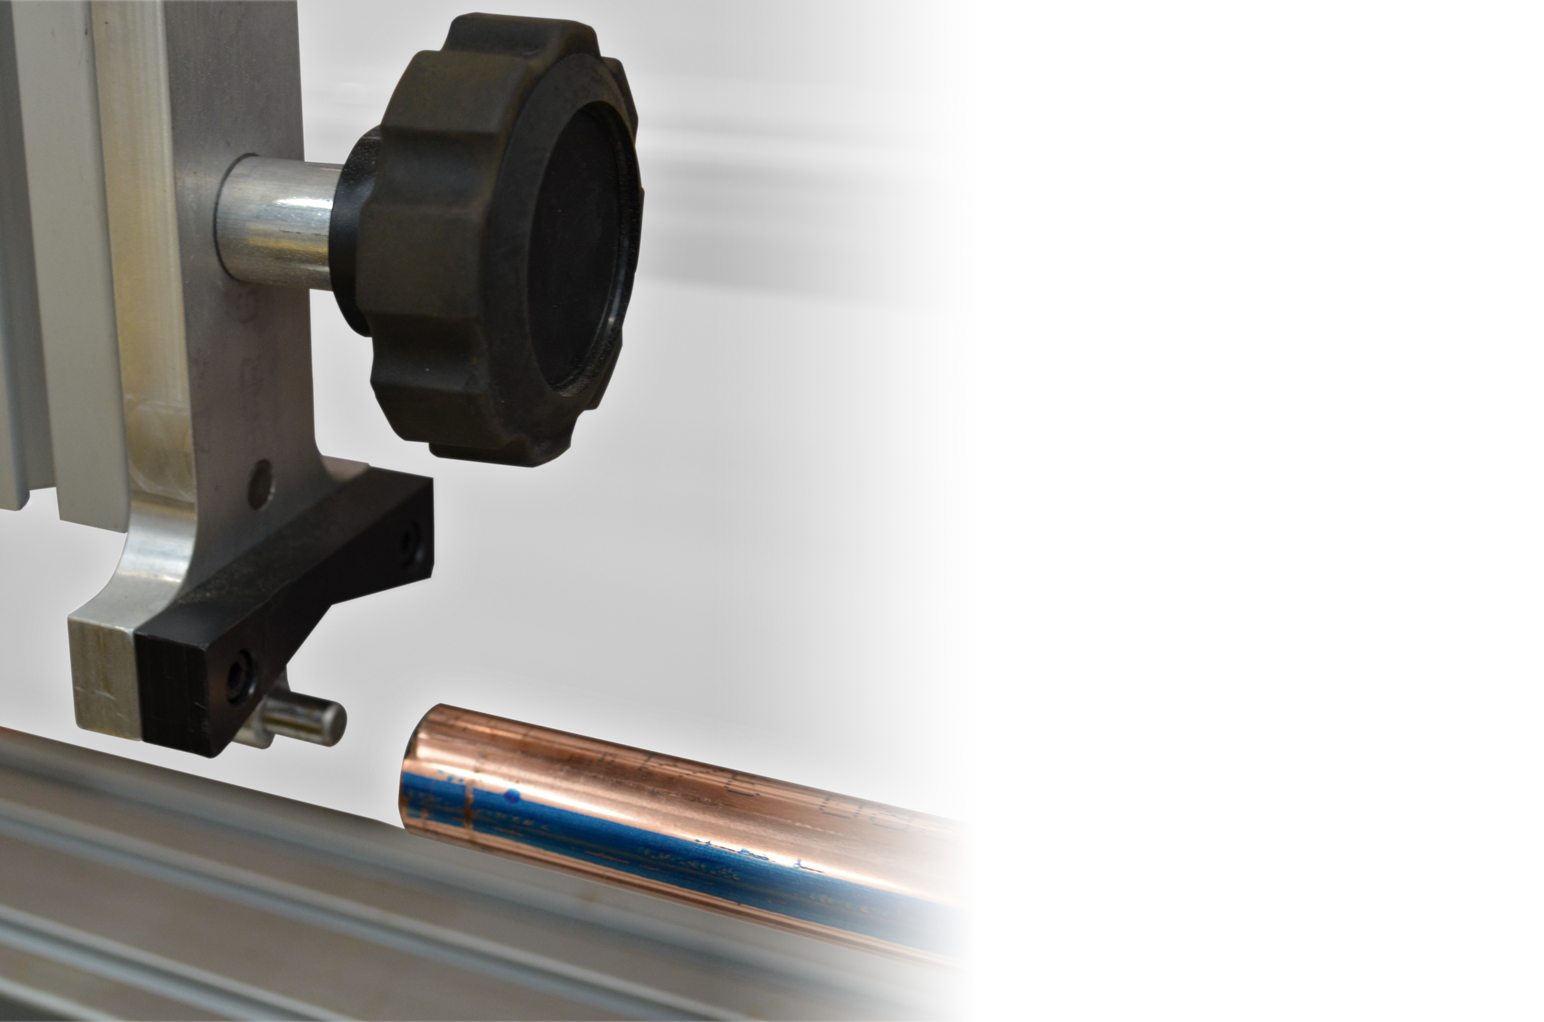

INTEGRATED
• Set and forget” integration with Stratus and
RazorGage saves valuable time and money.
• Cut multiple sizes in one production run.

